Slide 1



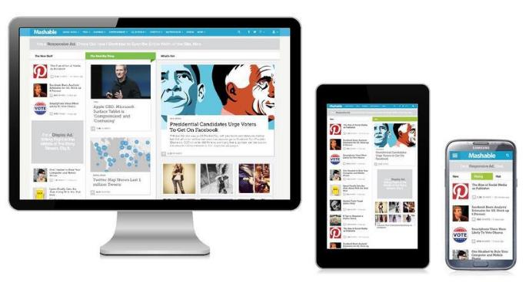
Responsive Design
Design that Adapts to Different Devices
Svetlin Nakov
Technical Trainer
www.nakov.com
Software University
http://softuni.bg

Slide 2

Table of Contents
Responsive Design
Creating Responsive Design
Fluid Layout
Flexible Images and Fonts
Flexible Tables and Menus
Media Queries
Media Queries Everywhere
Constructing Responsive Design

Slide 3
Responsive Design
Overview

Slide 4

Responsive Design
Responsive design (adaptive design) is an approach to optimize the viewing experience on range of devices
Better user experience on mobile, desktop, TV
The UI depends on the device and device specifics
Screen size
Screen resolution
DPI
Color range
Etc…

Slide 5
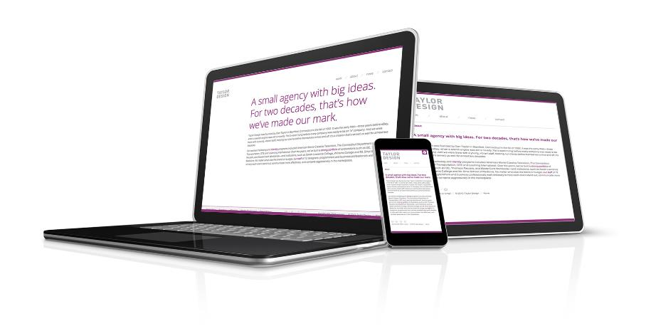
Responsive Design
Live Demo

Slide 6
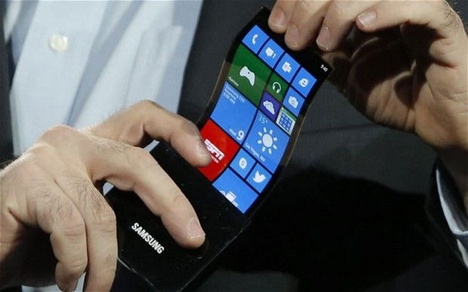
Creating Responsive Design
Ways to Implement a Nice UI

Slide 7
Creating Responsive Design
Responsive design involves one or more of the following:
Fluid layout
Use proportional values for widths, margins, etc…
Flexible fonts
Fonts based on the root
Flexible images
Images cannot go beyond their container
Media queries
Apply styles based on the client screen size

Slide 8


Fluid Layout
Make the Elements Flow on the Screen

Slide 9
Fluid Layout
Fluid layout uses proportional sizes
Pros:
UI responds better to the client resolution
Spares code on media queries
Cons:
More whitespace on large screens (TV)
Sub nav
content
aside
12%
60%
20%
Margins:2%

Slide 10

Fluid Layout
Live Demo

Slide 11
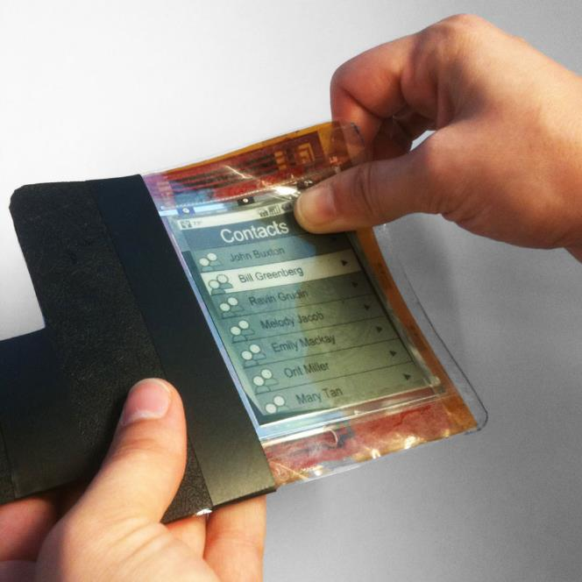
Flexible Images

Slide 12
Flexible Images
Fluid design gets broken when using elements with fixed size
By concept images are always with fixed size
Example:
Resolution: 1024px, container with width: 60% ( = 60% * 1024 = 614.4px) and an image with width: 500px
Seems OK
When the resolution becomes 780px, the container's width is still 60% (= 468px), and the images width is still 500px
The image overflows its container

Slide 13
Making Images Flexible
The fix to the image overflow is simple
Just a reset in the top of the CSS
max-width overrides the width property
If the image size is larger than the container's size → the image gets the entire container's width
img { max-width:100%; }

Slide 14
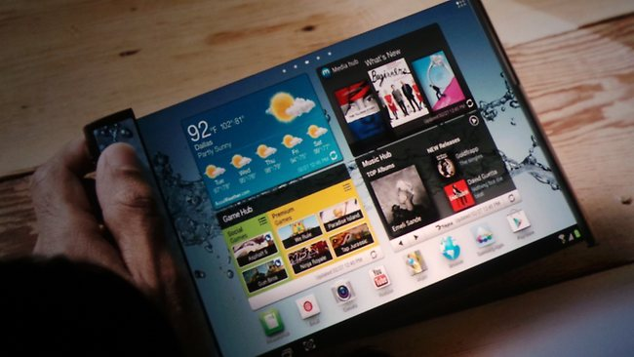
Flexible Images
Live Demo

Slide 15
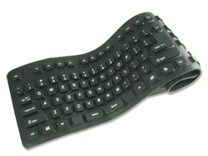
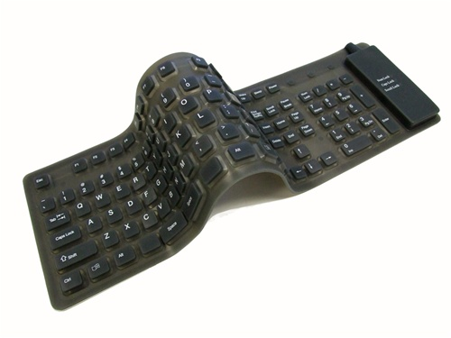
Flexible Fonts

Slide 16
Flexible Fonts
Flexible fonts means proportional font size
Based on the context (parent)
Instead of pixels use proportional values (em)
Make all font sizes based on the context
To change the font-size of all elements just change the context's font-size

Slide 17
Flexible Fonts (2)
Making fonts "responsive" needs a little math
ems = target / root
1.4375em = 23px / 16px
body { font-size: 16px; }
body header { font-size: 23px; } // 23 / 16 = 1.4375
body { font-size: 16px; }
body header { font-size: 1.4375em; }

Slide 18

Flexible Fonts
Live Demo

Slide 19
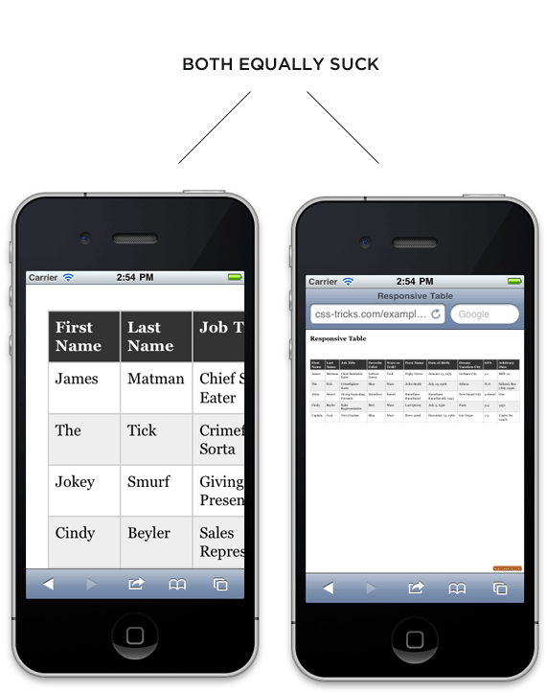
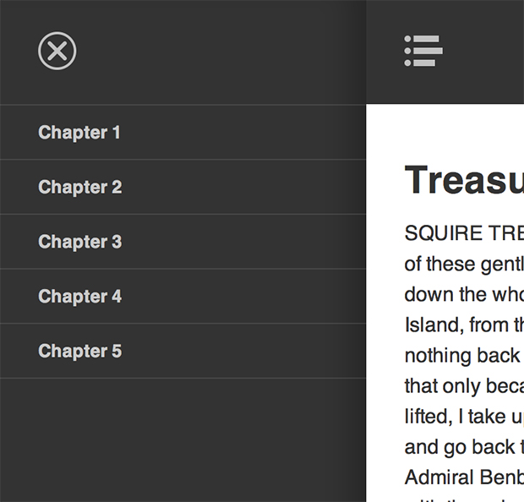
Flexible Tables and Menus

Slide 20
Responsive Tables and Menus
Responsive tables
Tables are ugly and not scalable
http://css-tricks.com/responsive-data-table-roundup/
Responsive menus
Menus take to much space
http://css-tricks.com/responsive-menu-concepts/

Slide 21
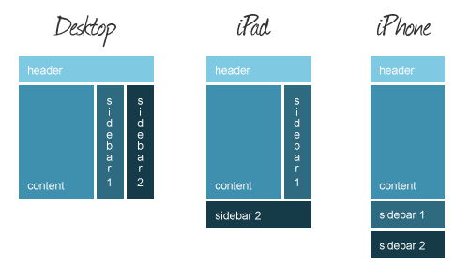
Media Queries

Slide 22
Media Queries
Media queries are part of CSS 3
Supported in all major browsers
A media query consists of a media type and at least one expression
By using media features like width, height and color
MQ change the presentation of content
Not the content itself

Slide 23
Media Queries (2)
Media queries apply CSS styles on certain conditions (media type and expression)
.box {width: 250px; height: 250px; display: inline-block}
@media only screen and (max-width: 1024px) {
.box { width: 300px; height: 300px; }
}
@media only screen and (max-width: 960px) {
.box { width: 310px; height: 310px;}
}
@media only screen and (max-width: 480px) {
.box { display: block; width: 95%; height: 95%; }
}

Slide 24
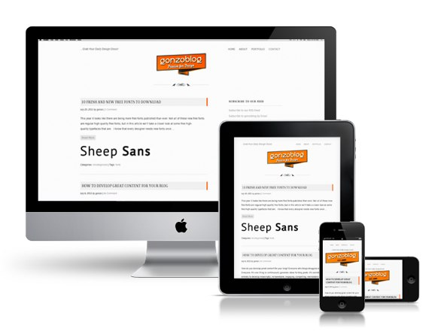
Media Queries
Live Demo

Slide 25
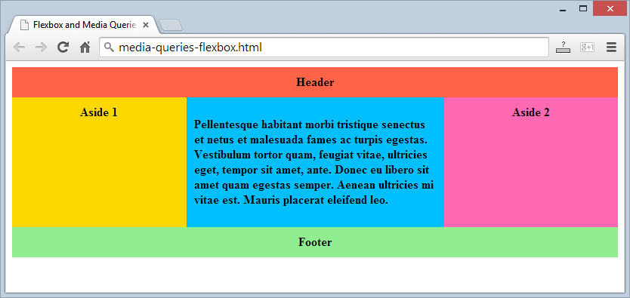
Media Queries and Flexbox
Responsive Design with Flexbox

Slide 26

Summary
Responsive design involves
Fluid layouts
Flexible Images
Flexible fonts
Media queries
Media queries syntax:
@media screen and (max-width: 480px) {
/* Apply styles for small devices (phones) */
}

Slide 27
Responsive Design
https://softuni.bg/courses/web-fundamentals/

Slide 28
License
This course (slides, examples, demos, videos, homework, etc.) is licensed under the "Creative Commons Attribution-NonCommercial-ShareAlike 4.0 International" license
Attribution: this work may contain portions from
"HTML Basics" course by Telerik Academy under CC-BY-NC-SA license
"CSS Styling" course by Telerik Academy under CC-BY-NC-SA license

Slide 29







SoftUni Diamond Partners

Slide 30




Free Trainings @ Software University
Software University Foundation – softuni.org
Software University – High-Quality Education, Profession and Job for Software Developers
softuni.bg
Software University @ Facebook
facebook.com/SoftwareUniversity
Software University @ YouTube
youtube.com/SoftwareUniversity
Software University Forums – forum.softuni.bg

